Slide 1
MINI PROJECT ON Music Playlist
By-Prashant Rana
1NH17CS099

Slide 2
AIM OF THE PROJECT :
The agenda of this project is to organize songs and integrate them in accordance with the song artist and genre.
It asks for song and artist name and searches for that specific artist name in all default playlists and places them in correspondence to the result.

Slide 3
DESCRIPTION :
User is provided with 4 options:
list of playlists
create new playlists
adding songs to the track
Quit
List of playlists: Displays list of all default playlists and with this we can open, delete and clone the playlist.
Create new playlist: Allows the user to create a playlist and add songs to it.

Slide 4
4. Adding songs to the track: Moves the new songs to the default playlist in accordance to the artist and genre.
5. Quit: It finally terminates the source code after execution.

Slide 5
REQUIREMENTS :
Software Requirements –
Windows 7 (or) Windows 10.
Turbo C/C++ terminal.
Hardware Requirements -
processor i3,i5;
Hard disk 500 GB
memory 1GB RAM

Slide 6
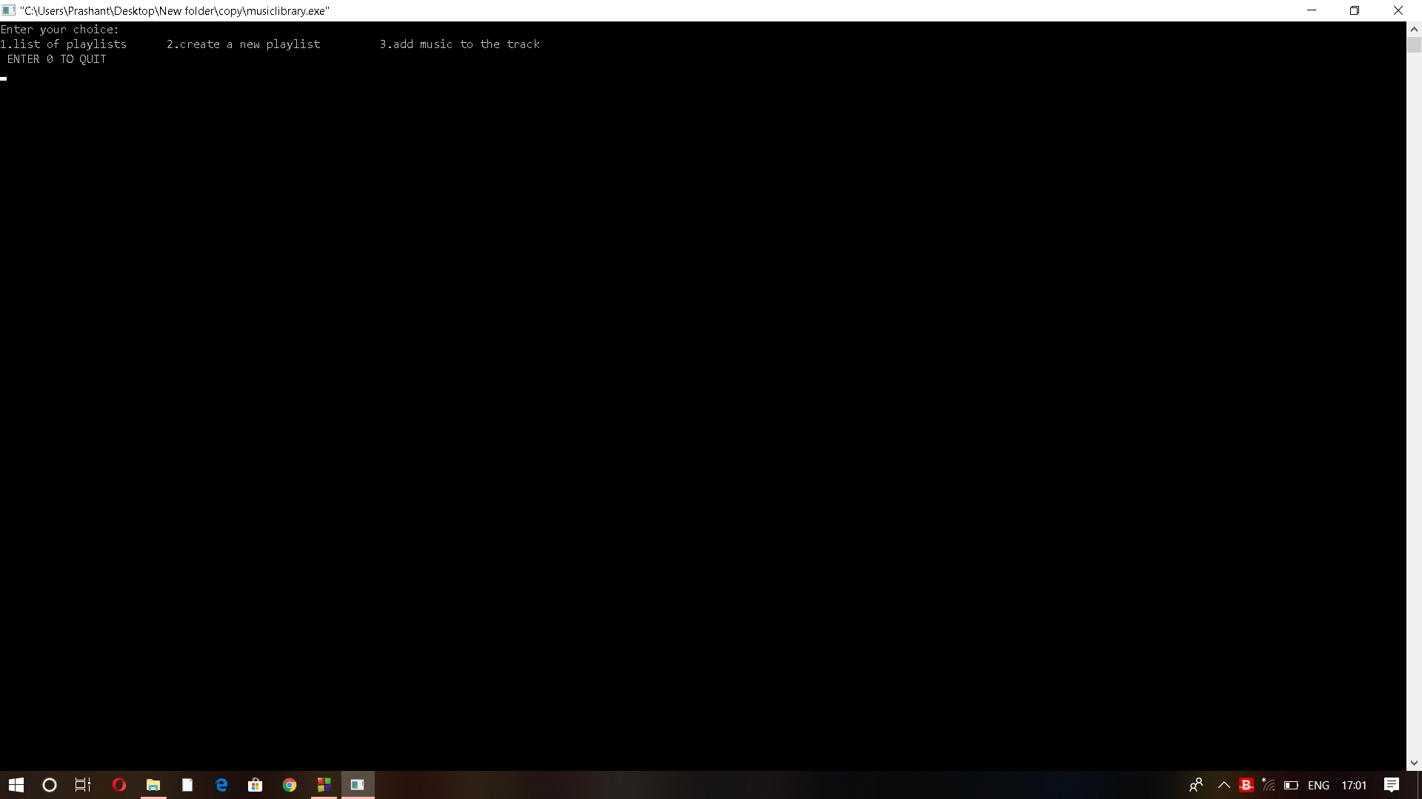
Sample Output

Slide 7
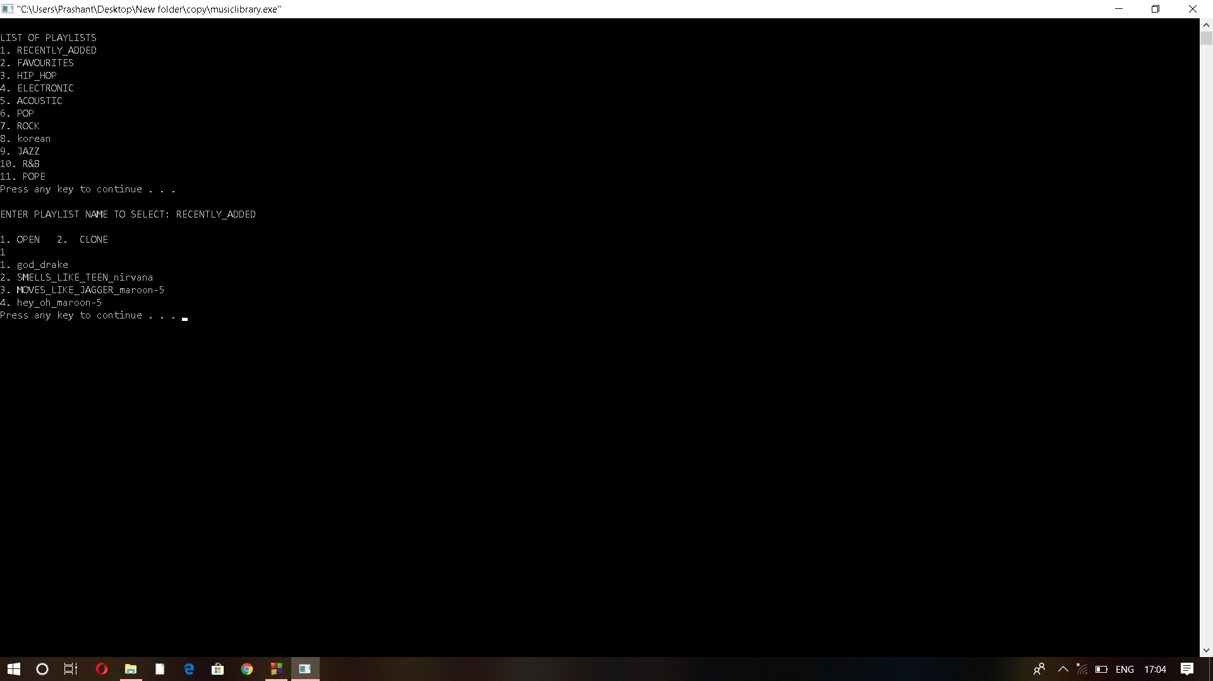

Slide 8
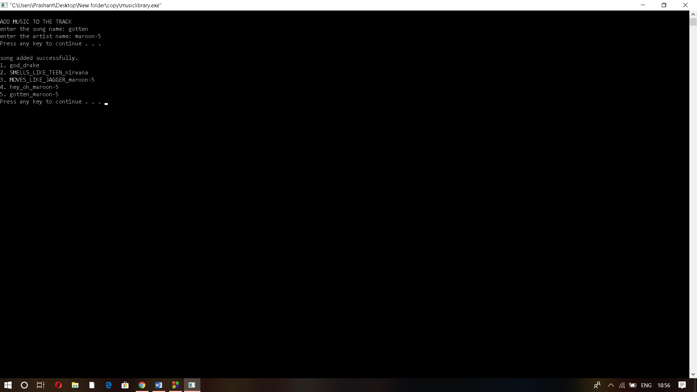

Slide 9
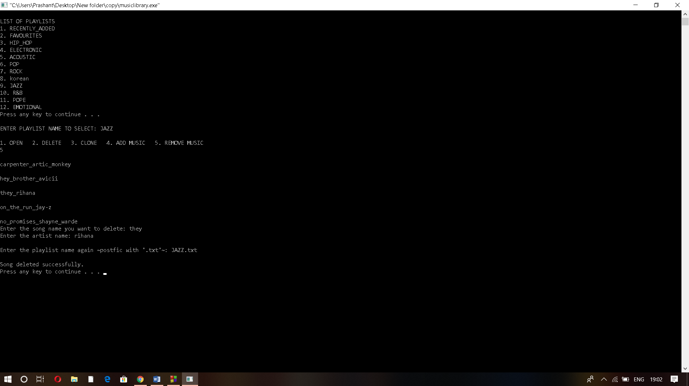

Slide 10
CONCLUSION
This program was specifically targeted to the consumers who have trouble finding good music organization features in music player application.
So, I think adding this feature to music application will help in making it more preferable to the users.
To conclude, I am very grateful for this mini project course, as this helped me get good knowledge about the concepts of OOPS in C++ .

Slide 11
THANK YOU….

